Slide 1
Open Exploration
Thompson, Wright & Bisset (2020; eLIFE)
Tuff & Bignardi

Slide 2
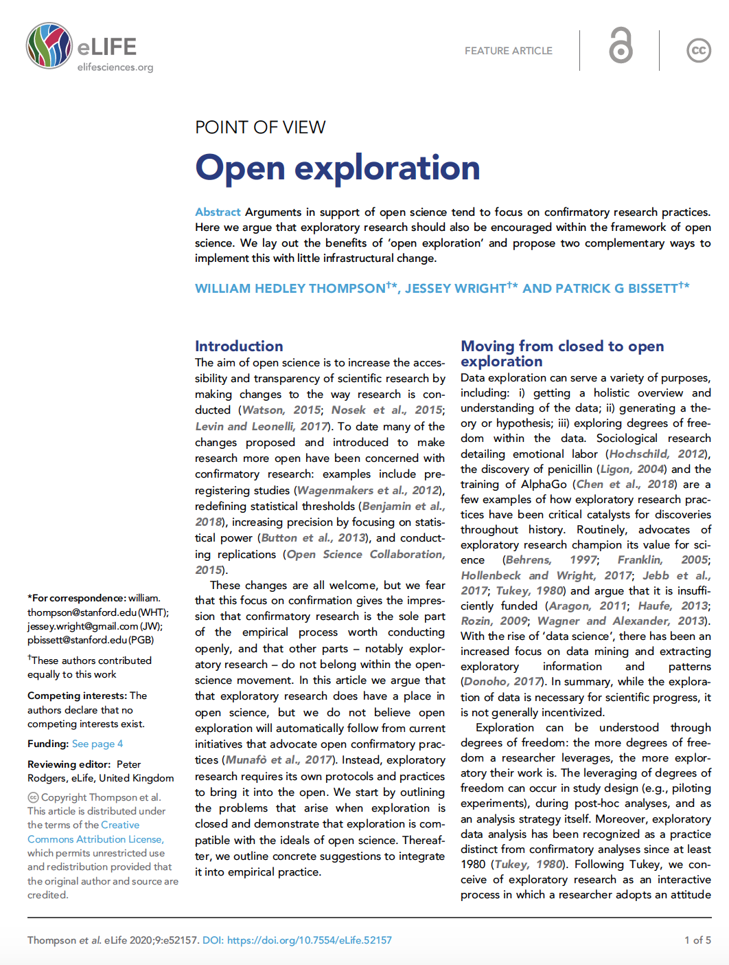
Intro | From closed to open | Proposed Implementation | Conclusion | Why does it matter?
References:
Thompson, Wright, & Bisset, 2020.
Intro
From closed to open
Proposed Implementation
Conclusion
Why does it matter?

Slide 3
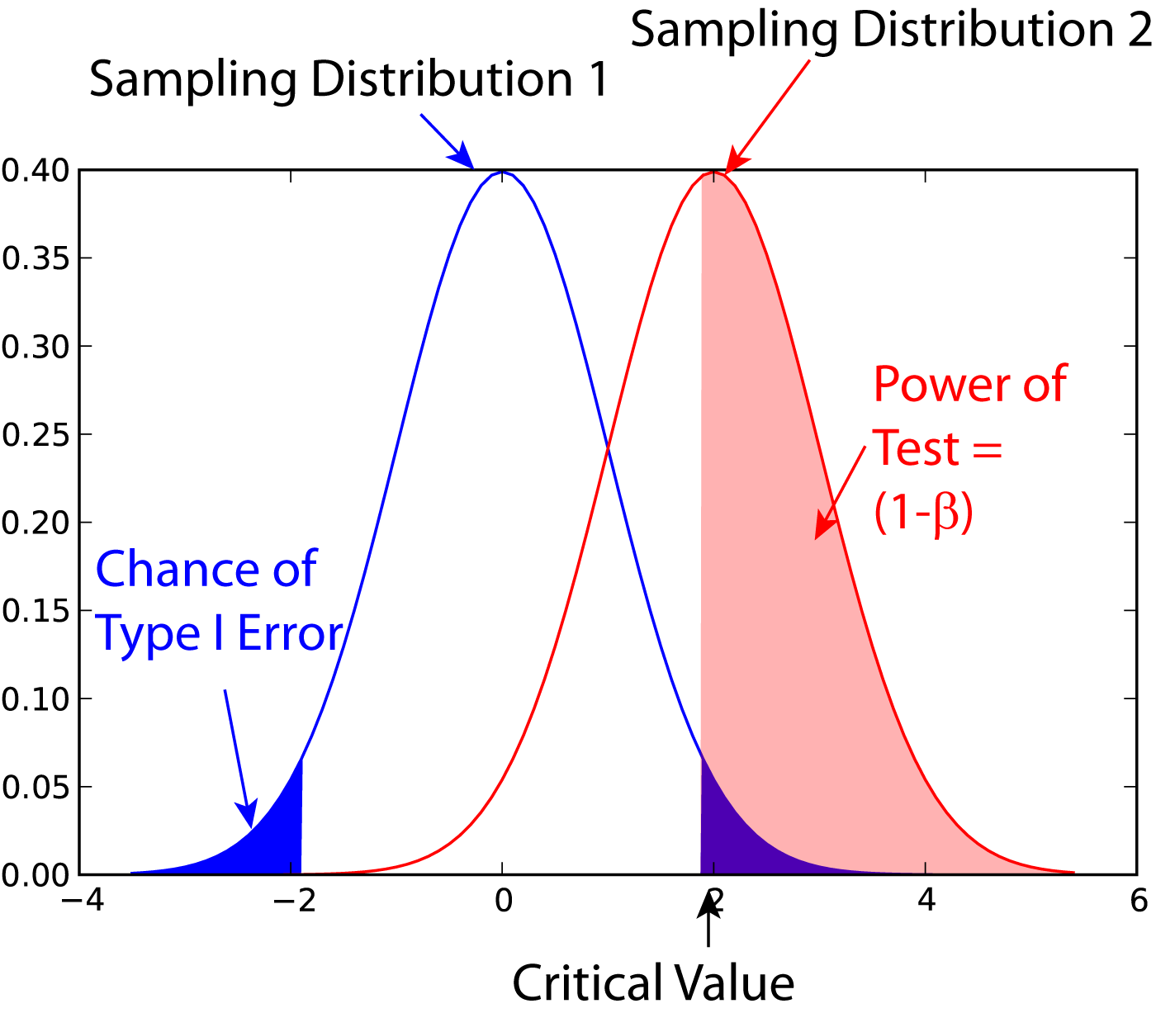


Intro | From closed to open | Proposed Implementation | Conclusion | Why does it matter?
References:
Thompson, Wright, & Bisset, 2020.
Aim of open science: increase accessibility and transparency of scientific research
Preregistration
Statistics
Replications
Mainly apply when we have hypotheses we want to test (confirmatory research)
Notes:
Statistics: redefining significance thresholds, focussing on statistical power

Slide 4

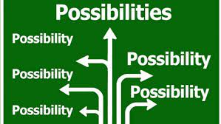

Intro | From closed to open | Proposed Implementation | Conclusion | Why does it matter?
References:
Thompson, Wright, & Bisset, 2020.
Exploratory research (no a priori hypotheses)
Overview of data
Generating theories
or hypothesis
Taking advantage of degrees of freedom
Exploratory and confirmatory research very different, but complement each other
Notes:
Catalyst for discoveries within data science and artificial intelligence, thorugh extracting exploratory information and patterns

Slide 5
Intro | From closed to open | Proposed Implementation | Conclusion | Why does it matter?
- Current open science policies are not adequate for exploratory science
References:
Thompson, Wright, & Bisset, 2020.
Exploratory research (no a priori hypotheses)
Overview of data
Generating theories
or hypothesis
Exploring degrees
of freedom
Exploratory and confirmatory research very different, but complement each other

Slide 6

Intro | From closed to open | Proposed Implementation | Conclusion | Why does it matter?
- Current open science policies are not adequate for exploratory science
References:
Thompson, Wright, & Bisset, 2020.
Exploration often not made public
Typical paper:
Authors omniscient?
Exact correct hypothesis known a priori
Small number of confirmatory statistical tests
Tests came out exactly as predicted
In reality, often exploratory science before confirmatory analyses, but these are not reported
Funding agencies and journals reinforce these practices

Slide 7


Intro | From closed to open | Proposed Implementation | Conclusion | Why does it matter?
- Current open science policies are not adequate for exploratory science
References:
Thompson, Wright, & Bisset, 2020.
Problems with closed exploratory research
Missed learning opportunities
(difficult for young researchers to improve own exploratory practices)
Mischaracterization
(exploratory science presented as confirmatory)
Notes:
Mischaracterization to fit with the tight linear confirmatory narrative that journals like to see

Slide 8


Intro | From closed to open | Proposed Implementation | Conclusion | Why does it matter?
- Current open science policies are not adequate for exploratory science
References:
Thompson, Wright, & Bisset, 2020.
Problems with closed exploratory research
File drawer problem
(studies go unreported)
Confirmatory research perceived as only scientific process worth doing
Notes:
File drawer: waste of time and resources on studies that others already know will not work
While exploration remains closed, confirmatory research will be perceived as only scientific process worth doing, discouraging resaearchers from good and thorough exploration

Slide 9
Intro | From closed to open | Proposed Implementation | Conclusion | Why does it matter?
- Current open science policies are not adequate for exploratory science | - Current research system does not incentivize open exploratory science, which can lead to bad scientific “habits”
References:
Thompson, Wright, & Bisset, 2020.
Problems with closed exploratory research
File drawer problem
(studies go unreported)
Confirmatory research perceived as only scientific process worth doing

Slide 10

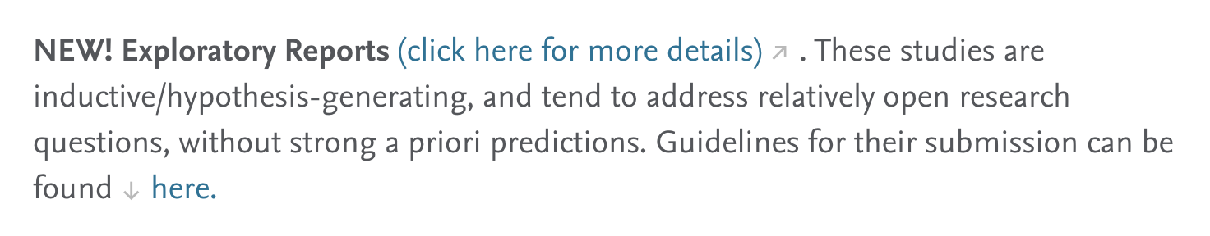
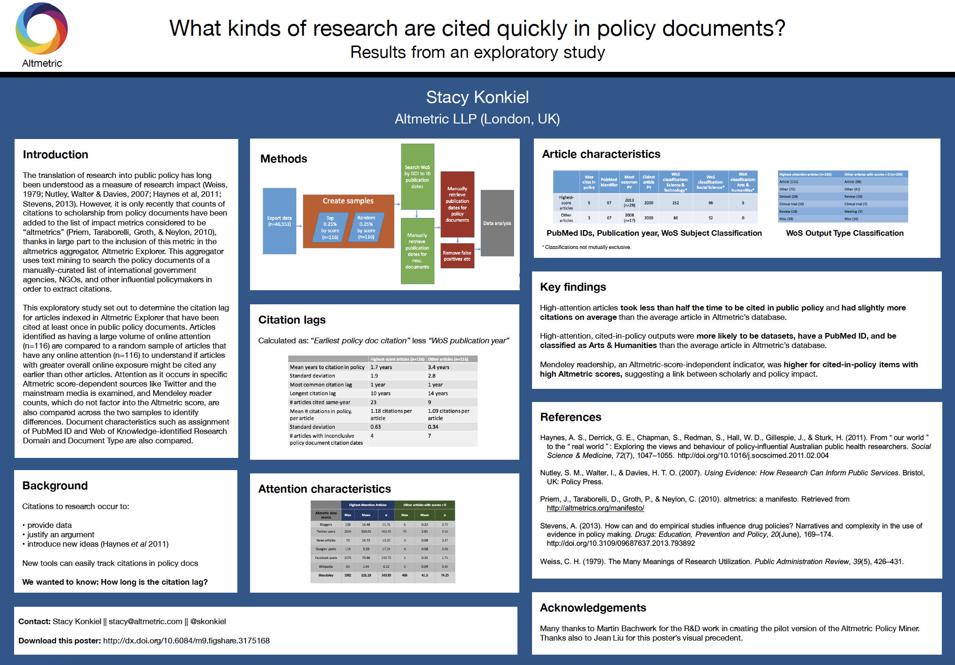
Intro | From closed to open | Proposed Implementation | Conclusion | Why does it matter?
- Current open science policies are not adequate for exploratory science | - Current research system does not incentivize open exploratory science, which can lead to bad scientific “habits”
References:
Thompson, Wright, & Bisset, 2020.
Exploration
Published
Published or not
Stand-alone section
Open repository
Methods
Results
Proposal
Examples

Slide 11
Intro | From closed to open | Proposed Implementation | Conclusion | Why does it matter?
- Current open science policies are not adequate for exploratory science | - Current research system does not incentivize open exploratory science, which can lead to bad scientific “habits” | - Standardized templates and open access repository are needed to match other types of scientific endeavor
Exploration
References:
Thompson, Wright, & Bisset, 2020.
…such section(s) would give researchers an opportunity to provide details about pilot studies, initial but incorrect hypotheses, and descriptive and exploratory data analyses that were conducted prior to the confirmatory part of the study…
The subsequent (confirmatory) methods and results sections will then be informed by the exploratory results reported in the paper and would be held to the strict standards of confirmatory science.
Confirmation
Stand-alone sections
Open repository
Methods
Results
Implementation

Slide 12

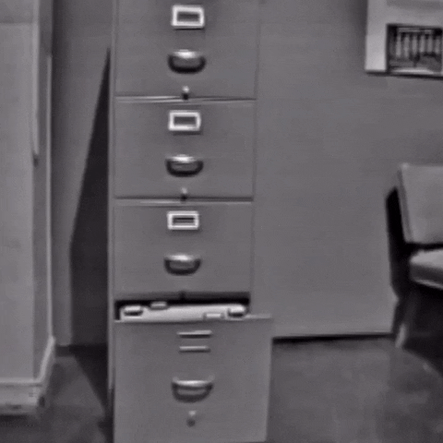

Intro | From closed to open | Proposed Implementation | Conclusion | Why does it matter?
- Current open science policies are not adequate for exploratory science | - Current research system does not incentivize open exploratory science, which can lead to bad scientific “habits” | - Standardized templates and open access repository are needed to match other types of scientific endeavor
References:
Thompson, Wright, & Bisset, 2020.
Benefits:
Open
Generating material
Allowing meta-exploratory studies
Open Exploratory research solve known problems (i.e., file drawer problem) becomes more honest (no omniscience), while improving learnability of young researchers

Slide 13
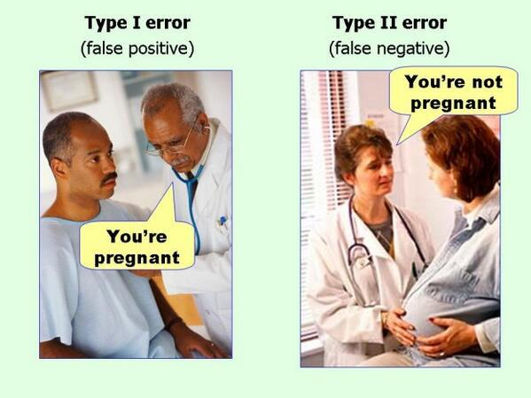
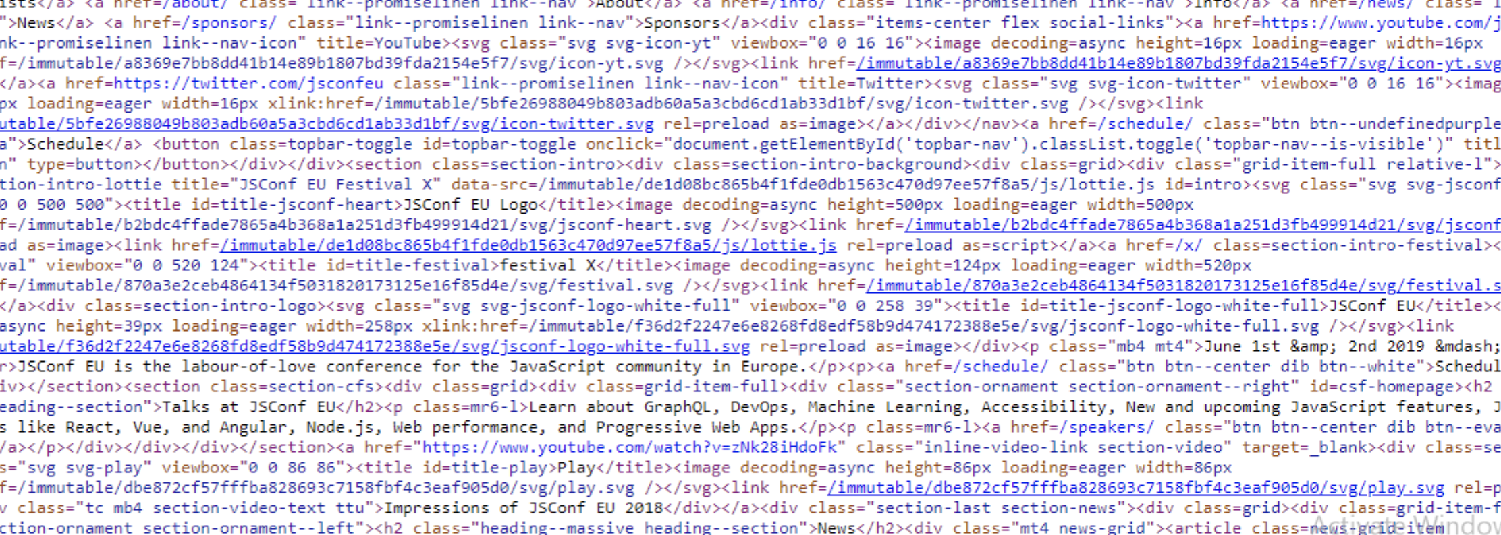
Intro | From closed to open | Proposed Implementation | Conclusion | Why does it matter?
- Current open science policies are not adequate for exploratory science | - Current research system does not incentivize open exploratory science, which can lead to bad scientific “habits” | - Standardized templates and open access repository are needed to match other types of scientific endeavor | - Open exploration will improve the quantity of available results and extend good practices to common scientific endeavor
References:
Thompson, Wright, & Bisset, 2020.
Concerns:
messy code
False negative and positive results
but these concerns should be solvable (incentives and awareness).

Slide 14
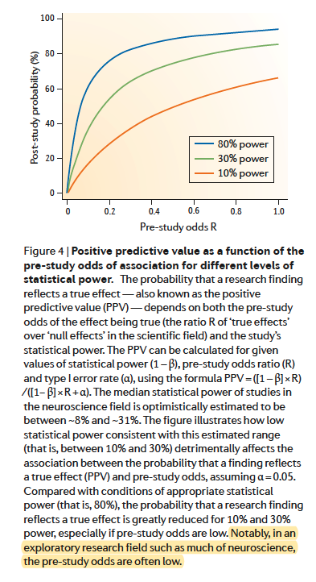
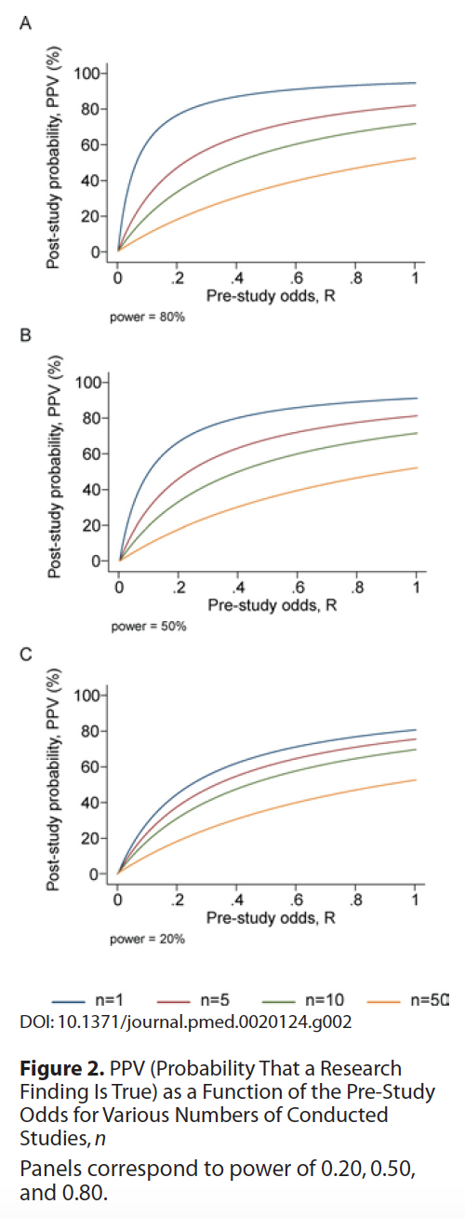
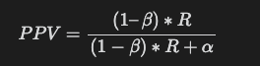
Intro | From closed to open | Proposed Implementation | Conclusion | Why does it matter?
- Current open science policies are not adequate for exploratory science | - Current research system does not incentivize open exploratory science, which can lead to bad scientific “habits” | - Standardized templates and open access repository are needed to match other types of scientific endeavor | - Open exploration will improve the quantity of available results and extend good practices to common scientific endeavor
References:
Button, et al 2013
Ioannidis, 2005
Positive Predictive Value:
is the probability that a ‘positive’ research finding reflects a true effect (that is, the finding is a true positive)

Slide 15

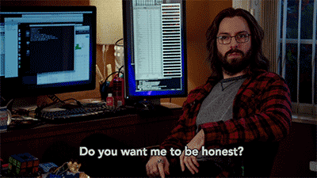
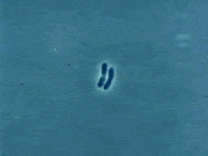
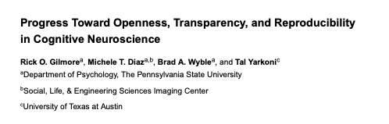
Intro | From closed to open | Proposed Implementation | Conclusion | Why does it matter?
- Current open science policies are not adequate for exploratory science | - Current research system does not incentivize open exploratory science, which can lead to bad scientific “habits” | - Standardized templates and open access repository are needed to match other types of scientific endeavor | - Open exploration will improve the quantity of available results and extend good practices to common scientific endeavor | - Learn, be honest, and reproduce!
LEARN
BE HONEST
& REPRODUCE!

Slide 16
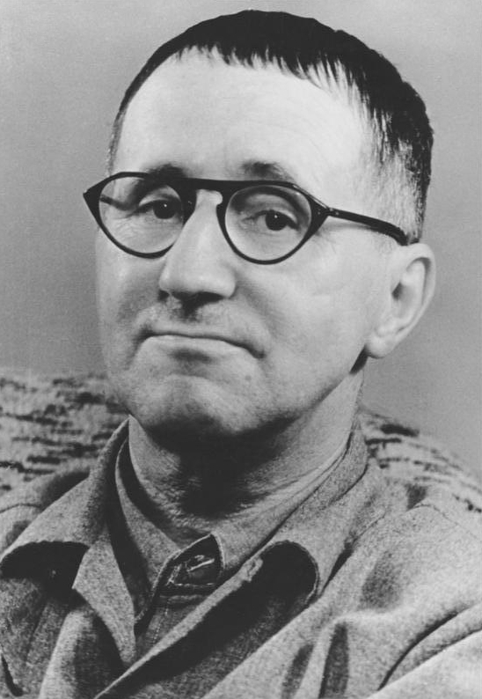
Intro | From closed to open | Proposed Implementation | Conclusion | Why does it matter?
- Current open science policies are not adequate for exploratory science | - Current research system does not incentivize open exploratory science, which can lead to bad scientific “habits” | - Standardized templates and open access repository are needed to match other types of scientific endeavor | - Open exploration will improve the quantity of available results and extend good practices to common scientific endeavor | - Learn, be honest, and reproduce!
References:
Thompson, Wright, & Bisset, 2020.
https://it.wikipedia.org/wiki/Bertolt_Brecht
Exploration
What problems
will this
implementation
resolve?
Can you see
any issues?
Confirmation
Stand-alone sections
Open repository
Methods
Results
Implementation

